Slide 1
Neah-Kah-Nie School District
2019-2023 Continuous Improvement Plan
Aligned to the Student Investment Account
March 3, 2020

Slide 2
Student Investment Account
Two stated purposes for funds under the Student Investment Account:
1
Meet students’ mental or behavioral health needs
Increase academic achievement for students, including reducing academic disparities for students:
That are economically disadvantaged;
From racial or ethnic groups that have historically experienced academic disparities;
With disabilities;
Who are English language learners;
Who are foster children;
Who are homeless; and
Any others as determined by the State Board of Education.
2
Notes:
This is the largest of the three funds that will disperse about $500 million every year is the Student Investment Account.
As you can see here, the fund has two stated purposes.

Slide 3
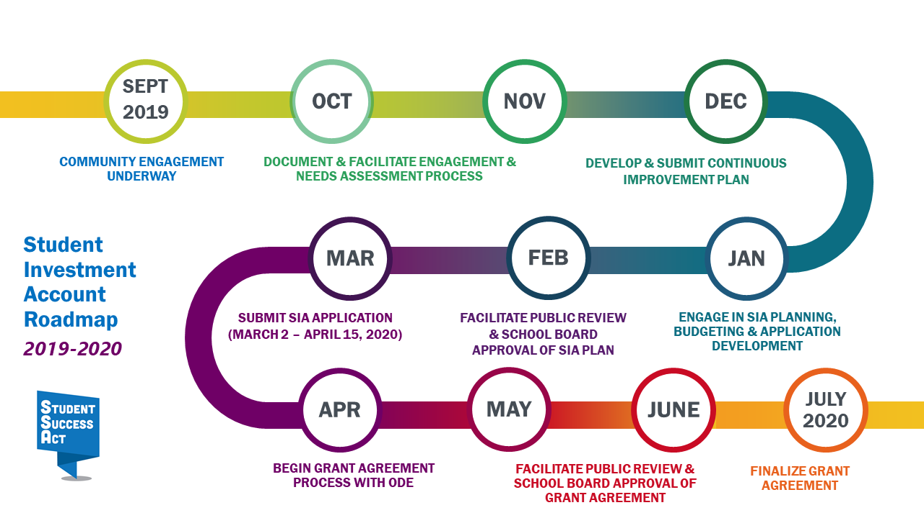
Student Investment Account

Slide 4
Student Investment Account
Allowable Use:
Reduce Class Size and Caseloads
Expand Instructional Time
Address Student Health and Safety
Provide a Well-Rounded Education
Notes:
Section 9
There are four intended uses for this new money.
Districts and charter schools will develop plans and budgets to spend Student Investment Account funds on:
Expanding Instructional Time
Reducing Class Size and Caseloads
Addressing Student Health and Safety
And Providing a Well-Rounded Education
I’m sure you’re already starting make connections with how your school could benefit from these funds, as these categories are quite inclusive and aligned with most school needs.

Slide 5
Student Investment Account
Performance Targets:
On-Time Graduation &
5-year Completion Rates
9th Grade On-Track
Locally Selected Metrics
Curbing Chronic Absenteeism
3rd Grade Reading Proficiency
Notes:
Section 12
Each grant will also include accountability metrics. Districts will need to identify performance targets in the following measures:
3rd Grade Reading
Regular Attenders
9th Grade On Track
4-Year Graduation
And 5-Year Completers
In addition, and hopefully to help provide an opportunity to track more timely progress, there will be an opportunity to set other locally-developed targets.

Slide 6
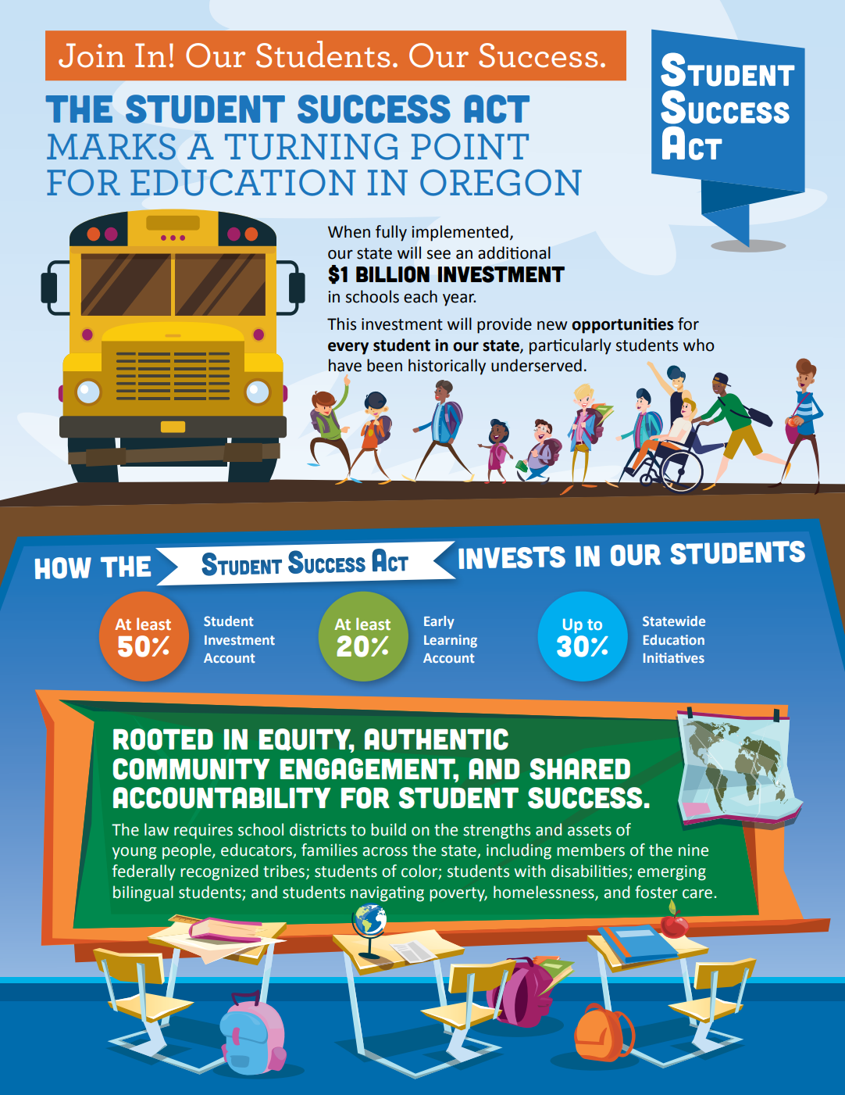
Student Investment Account
www.oregon.gov/ode/StudentSuccess
Online resources for families and community partners with update information posted regularly.
Notes:
Section 18

Slide 7
Mission
Neah-Kah-Nie School District prepares students to become productive and responsible citizens for an ever-changing world through diverse educational opportunities in partnership with the community
Values
Excellence - we prepare student for their future
Learning - we are all learning, every day
Rigor - we individualize our teaching and learning
Community - we build partnerships
Respect - we treat each other with respect and dignity
Diversity - we seek to understand and celebrate our differences
Collaboration - we work together and communicate effectively
Responsibility - we take responsibility for our work
Relevance - we are aware and responsive to those around us
Vision
The Continuous Improvement Plan was created through collaboration with parents, administrators, the board, staff, and community members, this CIP consists of a mission, values, and five goals with strategies to achieve these goals and key performance metrics to observe goal growth.

Slide 8
Goal 1: Improve 3rd Grade Reading Proficiency
If the District implements the following strategies with fidelity, then we will see growth in these metrics:
Strategies to Achieve Goal:
Expand pre-K options
Additional 1 FTE Lit. Coach
Sustained & focused PD support for teachers
100% RtII implementation
Evaluate effectiveness of K-3 reading core
Key Performance Metrics:
3rd grade reading performance (disaggregate data by student groups using district and state assessment data)
Students identified with deficits in phonemic awareness show X% growth
NKNSD 2019-2023 Long Range Plan with SIA Alignment

Slide 9
Goal 2: Improve Regular Attendance Rates
If the District implements the following strategies with fidelity, then we will see growth in these metrics:
Strategies to Achieve Goal:
Understand chronic absenteeism at the student-level PK-12
Improve school climate and culture
Implement school-based health center
Increase electives (STEAM) and after school/summer options (K-12)
Increase home-school communication, including bilingual (FRC)
Key Performance Metrics:
Regular attendance data by school and by student group
Student climate/culture survey data
School-based health center (# of students served)
NKNSD 2019-2023 Long Range Plan with SIA Alignment

Slide 10
Goal 3: Improve Rate of 9th Graders on Track
If the District implements the following strategies with fidelity, then we will see growth in these metrics:
Strategies to Achieve Goal:
Strengthen math/literacy core K-12
Faithfully implement 9th grade on track committee
Increase home-school communication, including bilingual
Strengthen transitions between schools (MS-HS)
Implement MS RTIi
Key Performance Metrics:
9th Grade on track data by student group
% students entering MS & HS at grade level
NKNSD 2019-2023 Long Range Plan with SIA Alignment

Slide 11
Goal 4: Improve Graduation and Completion Rates
If the District implements the following strategies with fidelity, then we will see growth in these metrics:
Strategies to Achieve Goal:
Improve cultural relevance across all content areas
Maintain senior engagement
Hire high school counselor
Key Performance Metrics:
4-Yr cohort grad rate by student group
5-Yr completion rate by student group
NKNSD 2019-2023 Long Range Plan with SIA Alignment

Slide 12
Goal 5: Improve Student Well-Being
If the District implements the following strategies with fidelity, then we will see growth in these metrics:
Strategies to Achieve Goal:
Healthier food/local options
PK-12 social emotional learning/TIC
Increase extracurricular participation for all students
Improve health instruction
Hire MS/HS counselors
Faithfully implement PBIS PK-12
Increase before and after school care options
Implement a school based health center
Key Performance Metrics:
# of students accessing nutrition services
Student survey (healthy behaviors, emotional intelligence, access to activities)
Healthy Teen Survey, fall 2020
# of students participating in extracurricular activities (by student group)
Decrease in drug/alcohol use
Decreased discipline referrals

